Slide 2
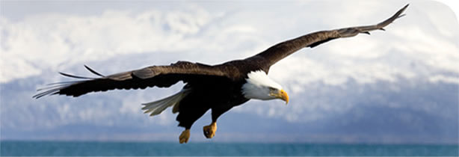
Notes:
ഈ പ്രപഞ്ചത്തിലെ ഏറ്റവും അത്ഭുതകരമായ പ്രതിഭാസമാണ്‌ ജീവൻ. ജീവന്റെ രഹസ്യം തേടിയുള്ള ഒരു അന്വേഷണമാണിത്.

Slide 3
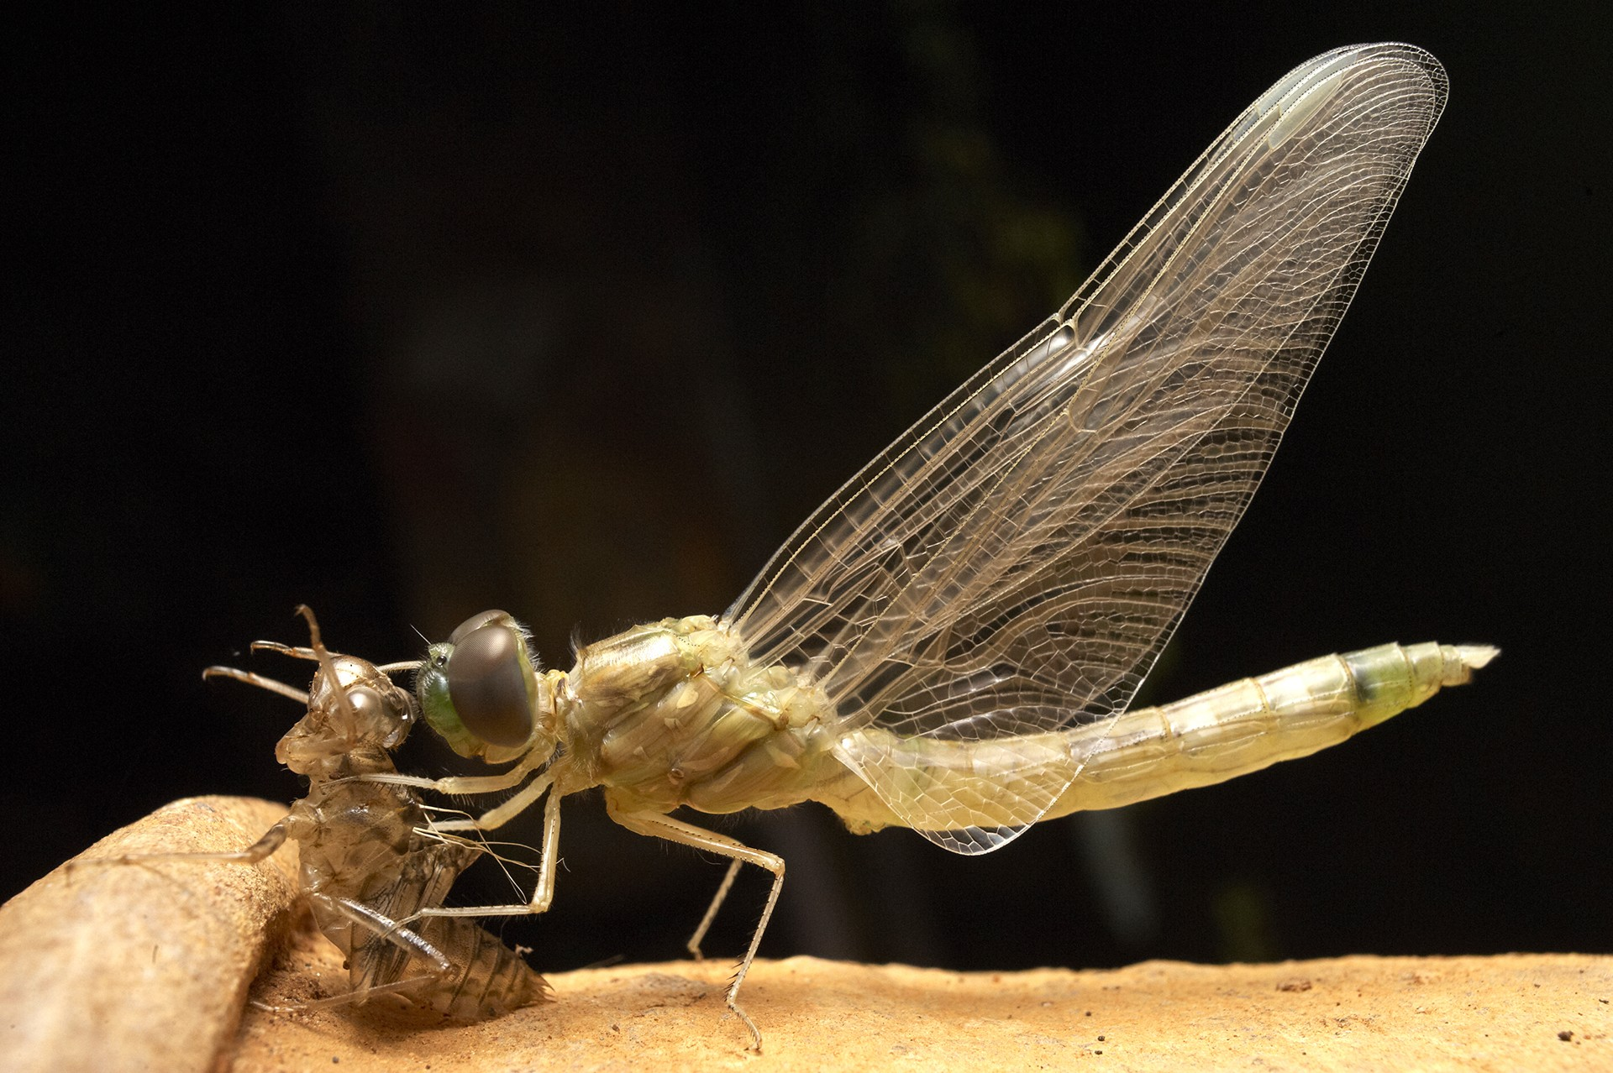
Notes:
ഭൂമിയിലെ വൈവിധ്യമാർന്ന ജീവനെയെല്ലാം കോർത്തിണക്കുന്ന കണ്ണികൾ എന്തെല്ലാമെന്നും അവയെല്ലാം എങ്ങനെ ഉണ്ടായി എന്നുമൊക്കെയുള്ളതിനെ പറ്റി ആധുനിക സയൻസിന്റെ കാഴ്ച്ചപ്പാടുകൾ ആണ്‌ ഇവിടെ അവതരിപ്പിക്കുന്നത്.

Slide 5
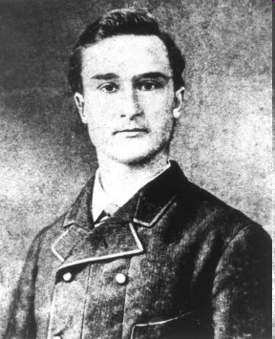
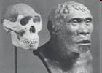
Notes:
The scientific history of the human race would not have been possible but for many great explorer-scientists who combined their love of adventure with their immense scientific curiosity.
Though Darwin had surmised that evolution of hominids was in Africa, very soon the majority opinion shifted to Asia as the most likely place for early hominid evolution.
Eugene Dubois gave up a prestigious academic career to go looking for the so called ‘missing link’ between apes and humans, in the remote islands of the Malay archipelago.
He was rewarded by the find of what came to be known as the Java man in Indonesia. We now recognize this as the ‘Homo erectus’.

Slide 6
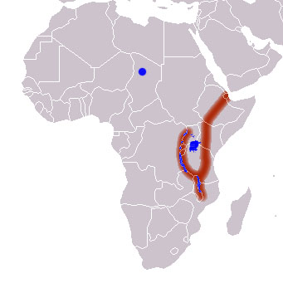
Notes:
The focus shifted back to Africa in the 20th century.
Much of the fossil evidence for the current view on human evolution has come from the great rift valley in Africa spanning from Ethiopia to East Africa.

Slide 7
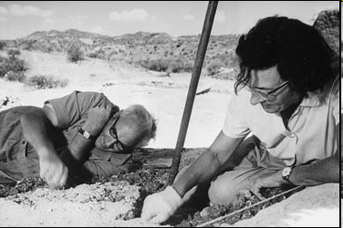
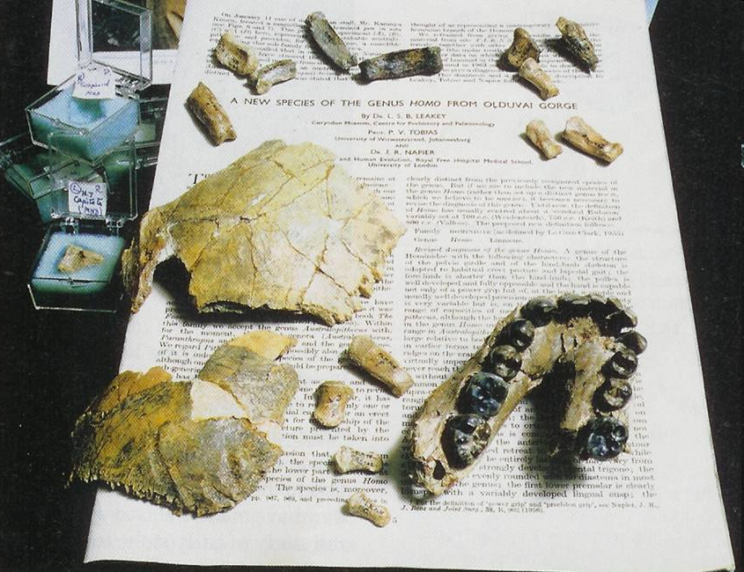
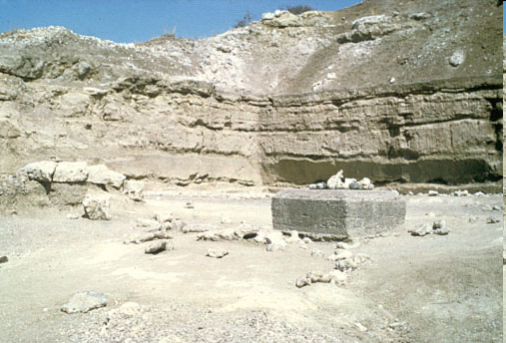
Notes:
The husband and wife team of Louis Leakey and Mary Leakey were pioneers in the exploration for human origins in Africa. The Olduvai gorge is a steep-sided ravine from where fossil remains of human ancestors have been found from as long as 2.5 million years ago. It is also a site from which very old stone tools dating to about the same time were unearthed.
These tools called Oldowan tools indicate that our hominid ancestors started using tools from as early as 2.5 million years ago.

Slide 8
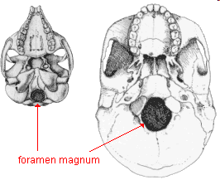
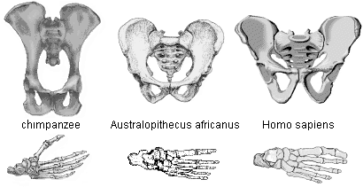
Notes:
How do we get clues regarding bipedalism from the available fossil evidence?
Foramen magnum is the large hole in the underside of the skull, through which the spinal cord passes. It is found towards the back in animals that walk on all four limbs like that of the chimpanzee on the left. In the bipedal and upright animals like humans, the foramen magnum is seen much more towards the center.
The way bones are joined together in the pelvis and foot and the shape of the leg bones and vertebrae also give us a good idea about bipedalism.

Slide 9
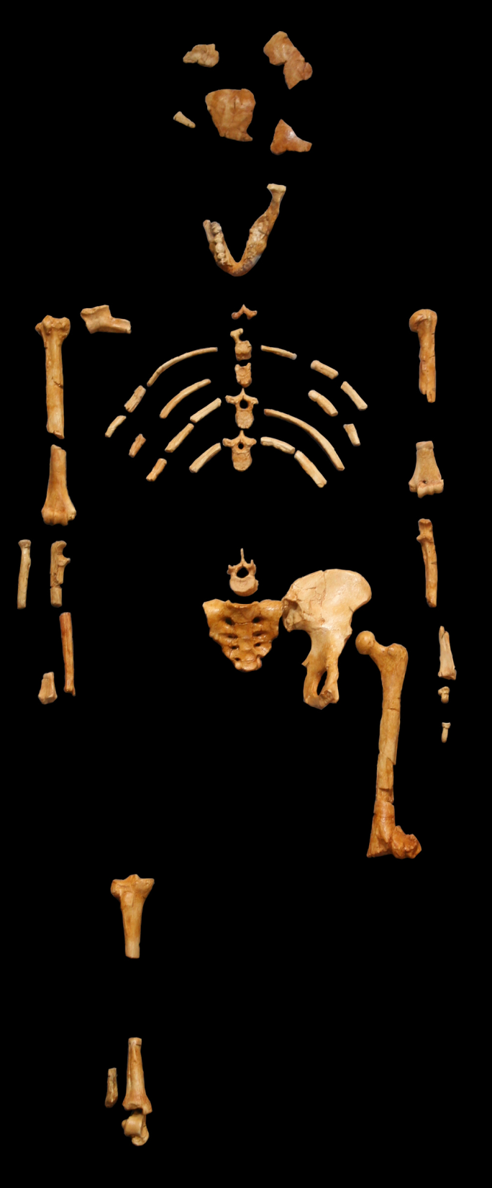
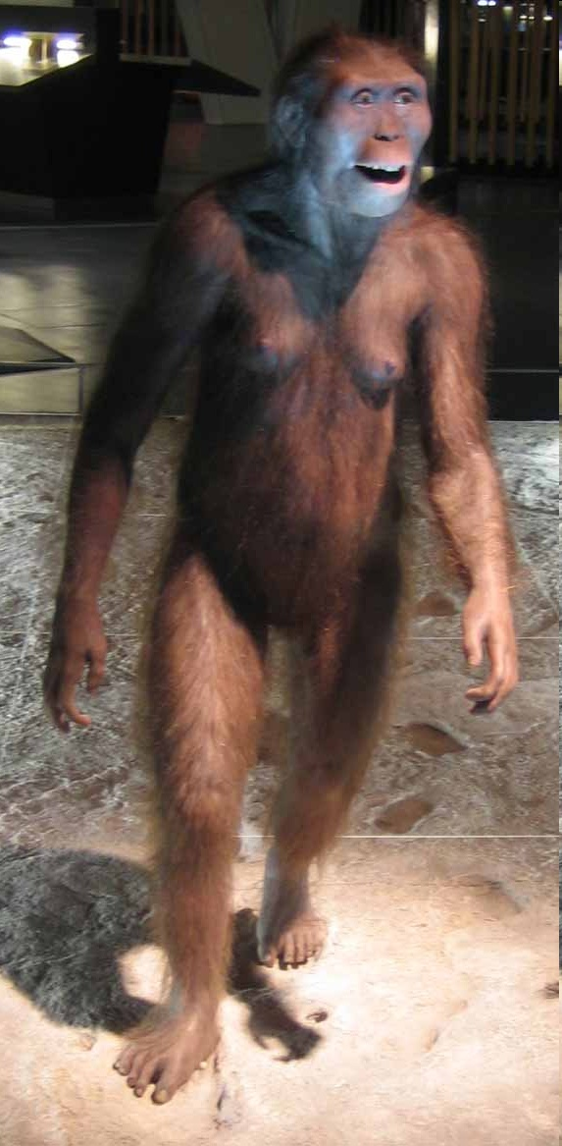

Slide 10
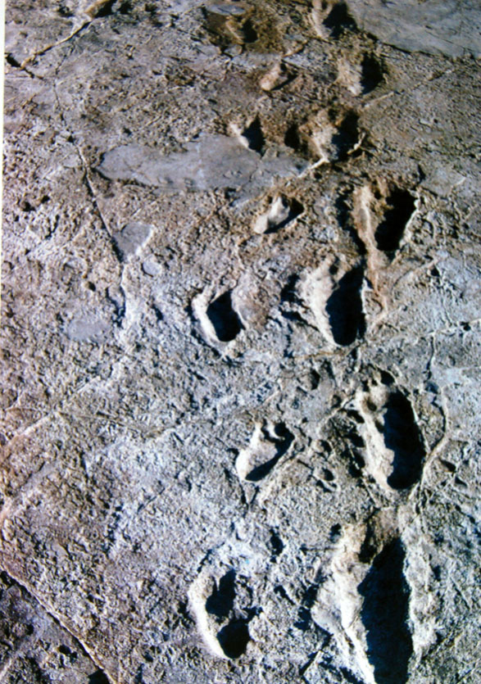
Notes:
36 ലക്ഷം വർഷം മുൻപ് ഇരുകാലിൽ നടന്നിരുന്ന ഒരു ജീവിയുടെ കാൽപ്പാടുകൾ ടാൻസാനിയയിലെ ലേറ്റോലി എന്ന എന്ന സ്ഥലത്ത് മേരി ലീക്കി കണ്ടെത്തി. അഗ്നിപർവതത്തിൽ നിന്നുള്ള പൊടിയിൽ പതിഞ്ഞ നിലയിലാണ് ഈ കാലടികൾ ഉണ്ടായത് എന്നത് കൊണ്ട് റേഡിയോ കാലനിർണയം വഴി `കൃത്യമായി എന്നുണ്ടായതാണെന്നു പറയാൻ കഴിഞ്ഞു.

Slide 11
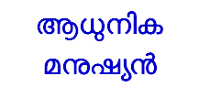

Slide 12
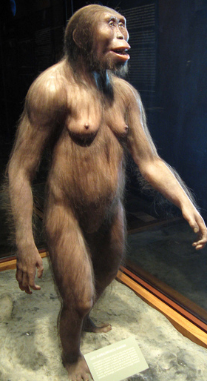
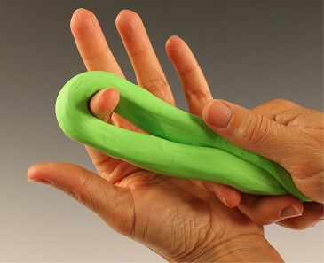
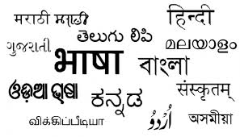

Slide 13
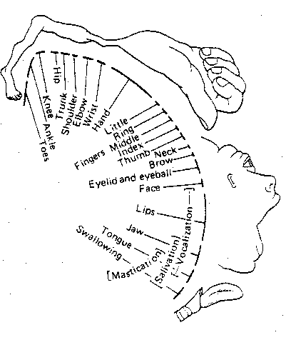
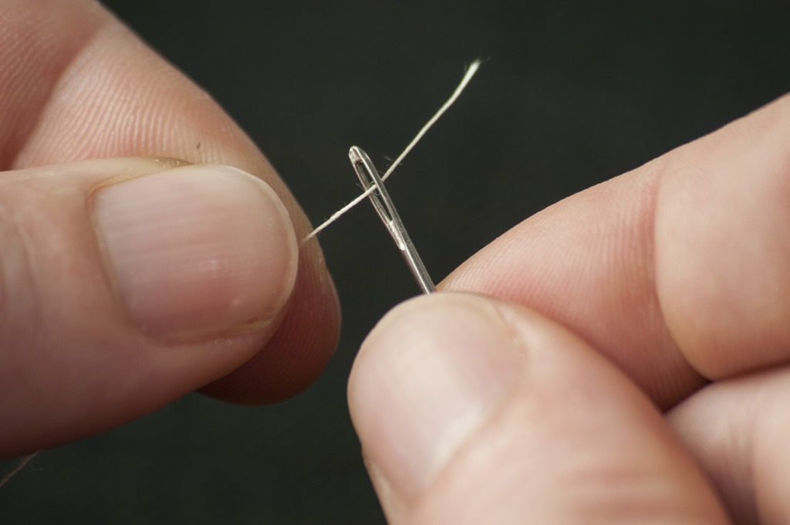
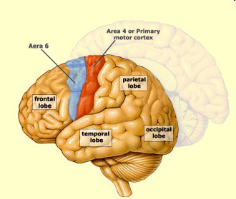
Notes:
This is the human brain. Areas shown in red and blue are those concerned with voluntary movements and their coordination. See the various parts of the body represented in the motor areas of the brain according to scale. Note that about one third of the area is just for the hand. Large area for speech.

Slide 14
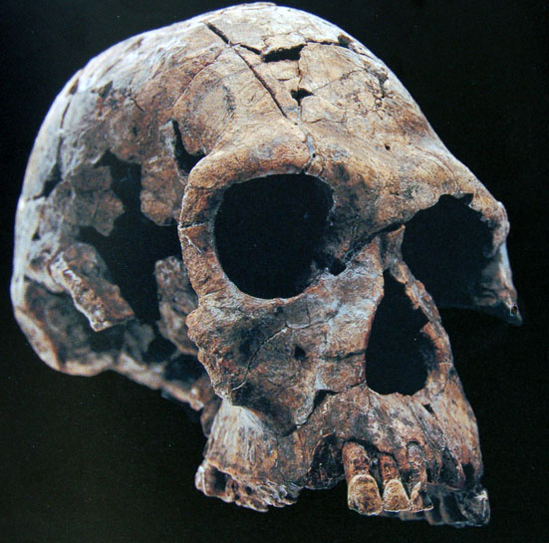
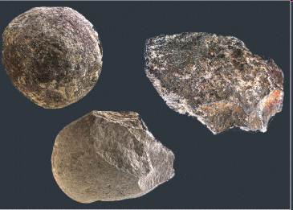
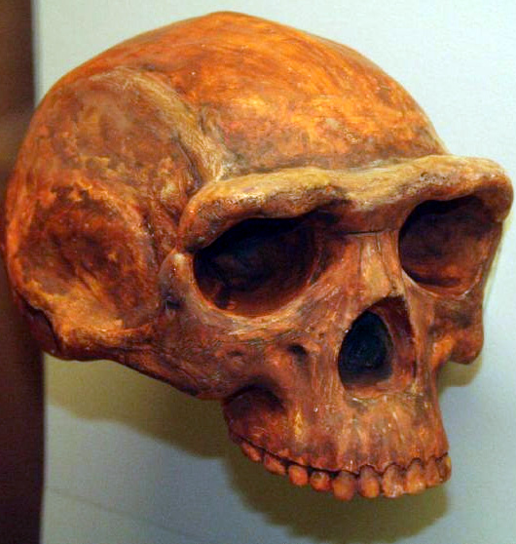
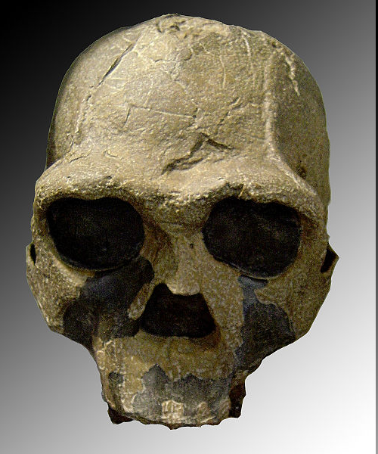
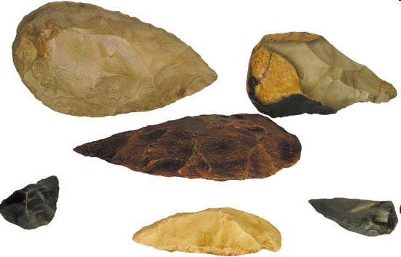

Slide 15
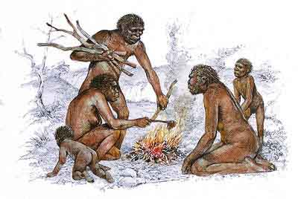

Slide 16
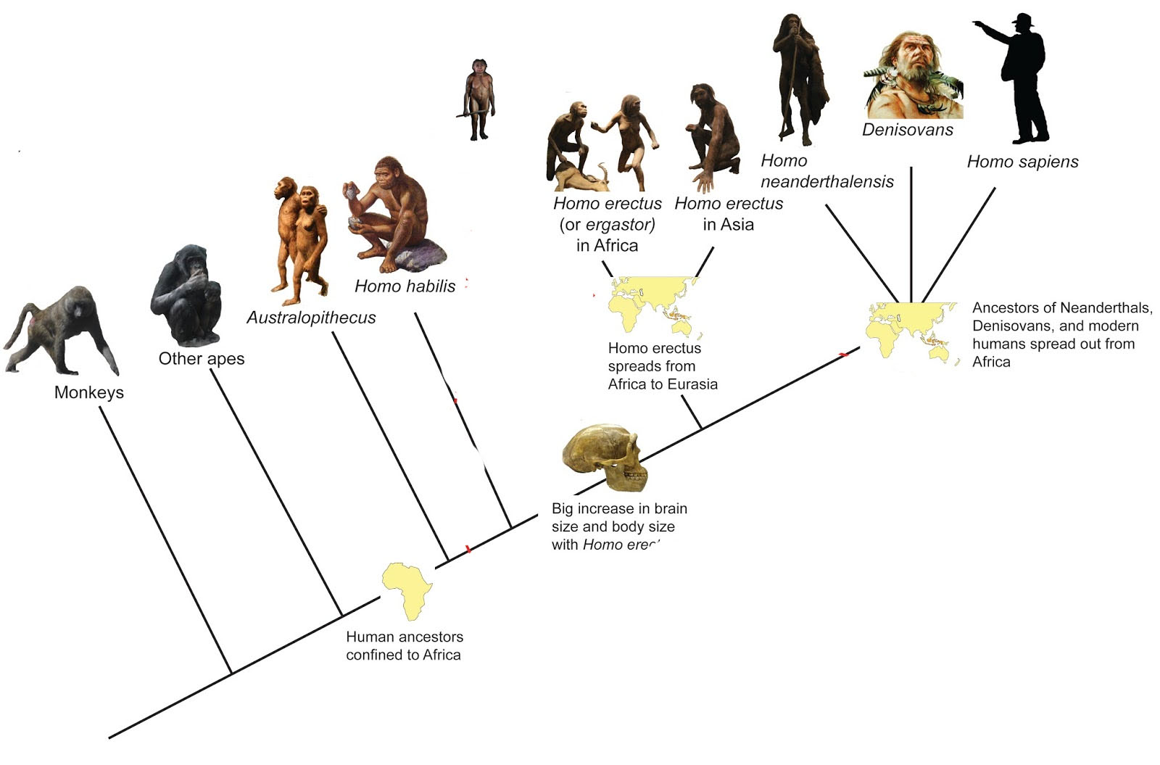
H florensis

Slide 17
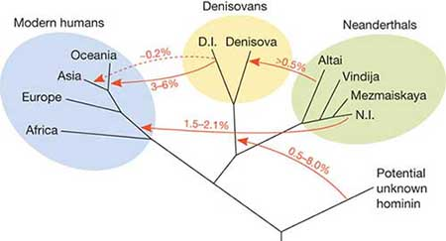

Slide 18
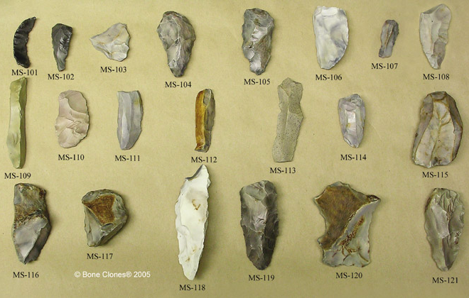
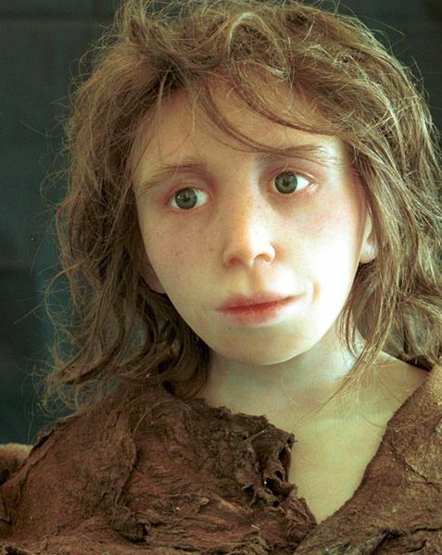
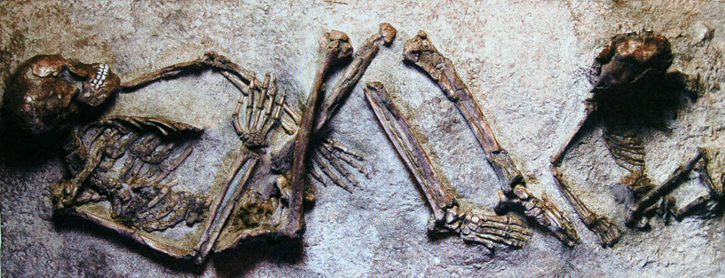
Notes:
The Neanderthals were our closest cousins. They spread from Africa to the colder climates of Europe and Northern Asia earlier than us. Their body was more adapted to cold. They were stockier and had large noses and a heavy ridges on the brows.
. Their tools were far more sophisticated than that of Homo erectus.
Reconstruction of how a Neanderthal girl would have looked like. We wouldn’t have recognized her in a crowd of modern humans as someone belonging to a different species.
Did we interbreed with the Neanderthals? Current evidence from DNA isolated from Neanderthal remains says to a very little extent.

Slide 19
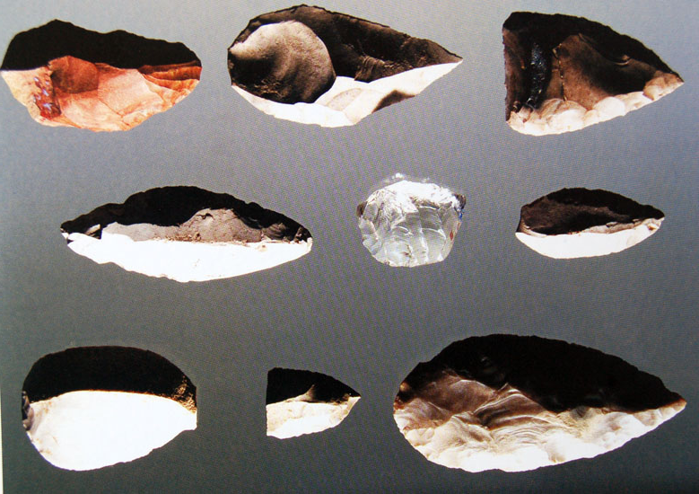
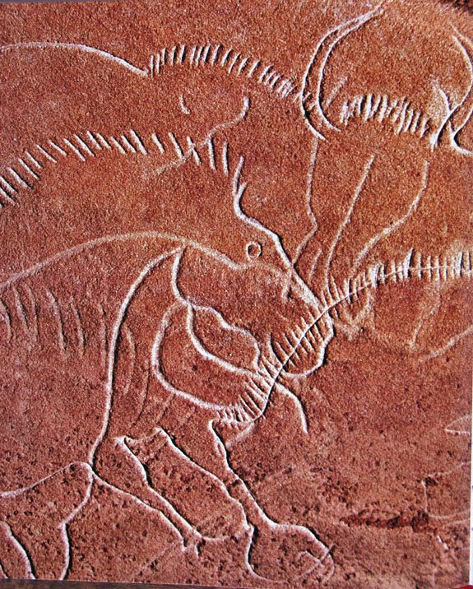
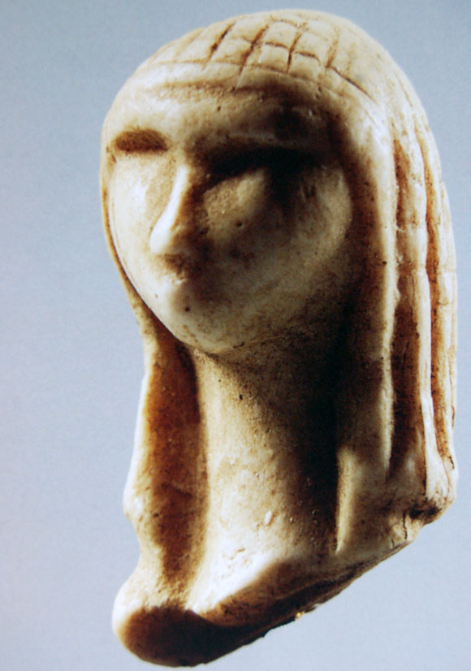

Slide 20
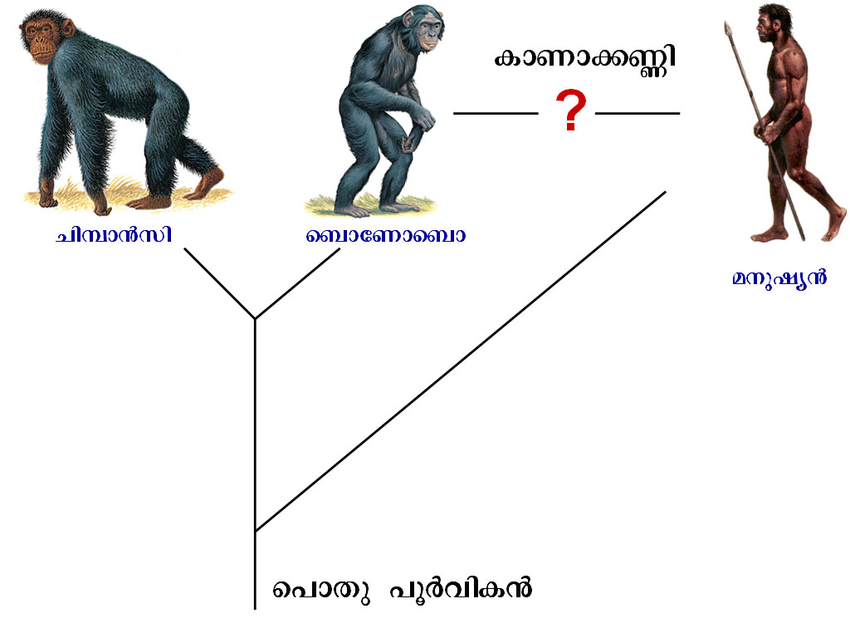

Slide 21
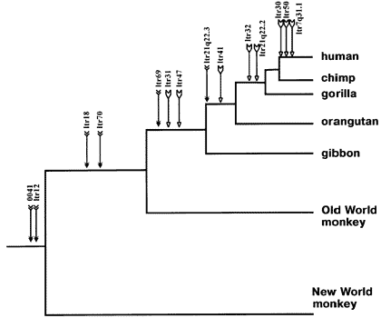
Endogenous retroviruses

Slide 22
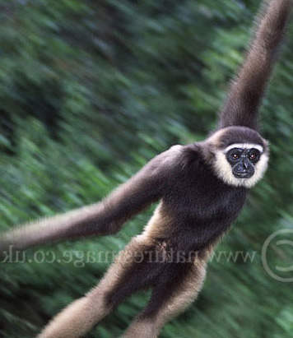
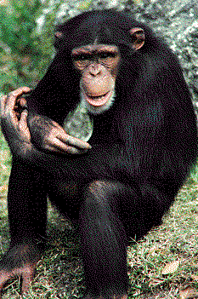
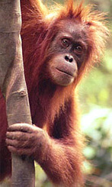
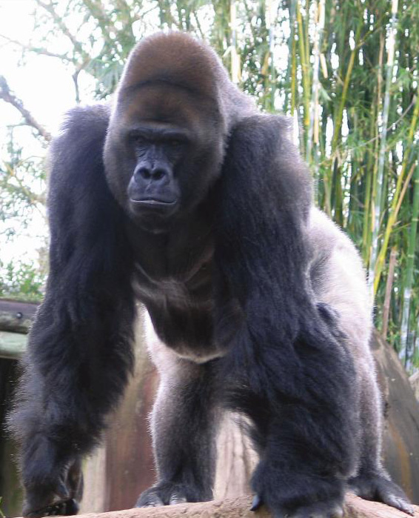
Number of Chromososmes
24x2
24x2
23x2
24x2
24x2

Slide 23
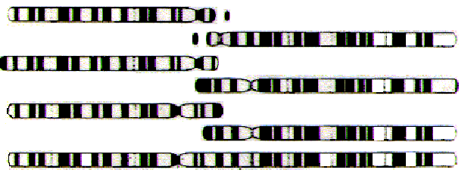
Orang
Gorilla
Chimp
Human

Slide 24
Ancestral Chromosomes
Fusion
Homo sapiens
Inactivated centromere
Telomere sequences
Centromere
Telomere
Testable prediction: Common ancestor had 48 chromosomes (24 pairs) and humans carry a fused chromosome; or ancestor had 23 pairs, and apes carry a split chromosome.

Slide 25
Human Chromosome #2 shows the exact point at which this fusion took place
“Chromosome 2 is unique to the human lineage of evolution, having emerged as a result of head-to-head fusion of two acrocentric chromosomes that remained separate in other primates. The precise fusion site has been located in 2q13–2q14.1 (ref. 2; hg 16:114455823 – 114455838), where our analysis confirmed the presence of multiple subtelomeric duplications to chromosomes 1, 5, 8, 9, 10, 12, 19, 21 and 22 (Fig. 3; Supplementary Fig. 3a, region A). During the formation of human chromosome 2, one of the two centromeres became inactivated (2q21, which corresponds to the centromere from chimp chromosome 13) and the centromeric structure quickly deterioriated (42).”
Homo sapiens
Inactivated centromere
Telomere sequences
Hillier et al (2005) “Generation and Annotation of the DNA sequences of human chromosomes 2 and 4,” Nature 434: 724 – 731.
Notes:
Indeed this was found as brought out in this paper published in 2005.

Slide 26
1
2

Slide 27
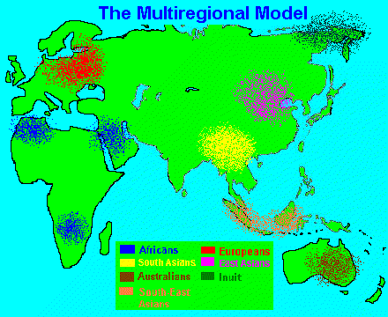
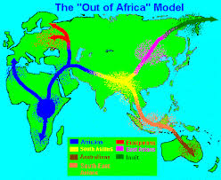

Slide 28
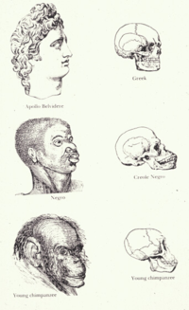
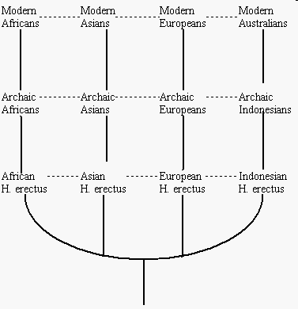

Slide 29
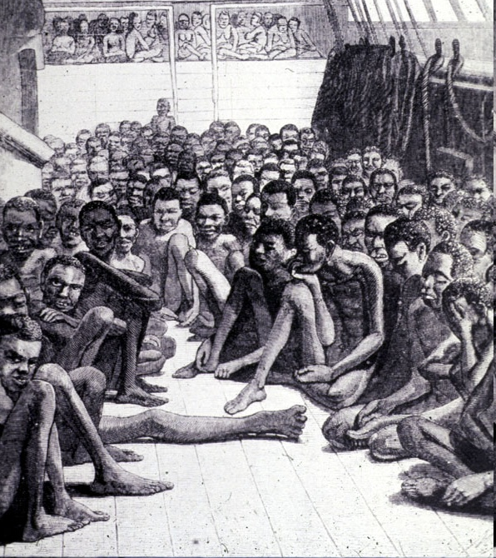
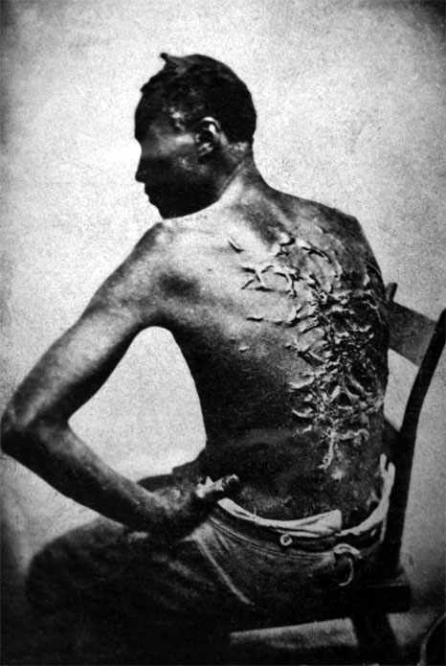

Slide 30
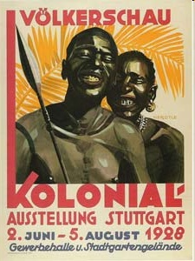
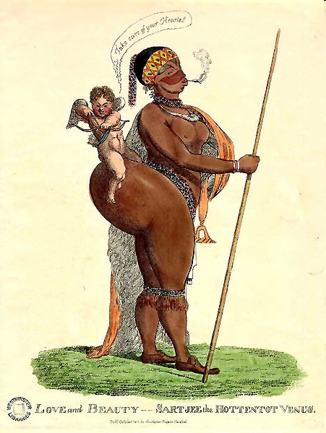

Slide 31
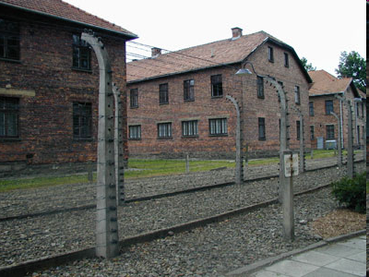

Slide 33
IQ
Notes:
The most recent pseudo-science is the theory of heritable racial differences in IQ. In its crudest form it states that
General intelligence or the ’g factor’ is inherited as a simple phenotypic trait
Determinant of IQ is predominantly genetic and environment has very little influence
There are IQ differences between races and the blacks are inferior in this respect.

Slide 34
Notes:
Even if a trait is almost fully heritable, the group differences need not be genetic.
In the example shown the height of corn plants is almost 100% heritable. But there is marked difference in height between plants that get adequate nutrients and those that do not.
janithakEthara

Slide 35
Notes:
The pseudo-scientific theories regarding racial differences and social inequality are sometimes called ‘Social Darwinism’. This is an unfortunate term since it has nothing to do with Darwinism.
Darwin himself believed in the unity of the human species and was against polygenic theory of races. He was a staunch opponent of slavery.

Slide 39
ATTTCGGCCTTACCGTTAAGTCCTTTTAAGT
ATTTCGGCCTTACCATTAAGTCCTTTTAAGT
ATTTCGGCCTTACCATTAAGTGCTTTTAAGT
ATTTCGGCCTTACCATTAAGTGCTTTTAAGA

Slide 44
Notes:
When mitochondrial DNA sequences from people living in different parts of the world are studied, they can be divided into different groups. They are named L, M, N etc. Depending on the mutation patterns it can be inferred which group followed which. For example L is the most ancient, additional mutations in the sequence gives rise to M, more mutations to N etc.
By looking at the predominant group found among indigenous people in each area, the patterns of migration can be inferred.
Such studies unmistakably point to Africa as the cradle of the human species.

